Slide 1
FYP-(Resources)
Luke Taylor

Slide 2
Project overview
Based on Internet of things, art installations and environmental sensing.
My aim is to build an interactive art piece that can visualise the consumption and environmental impact of resources within the home environment.
This idea could then be taken as an example and placed within the home to rival current modern smart meters from companies such as hive or British gas and take them in a different direction.

Slide 3
Background – Homes are too resource hungry
Domestic energy use accounts for more than a quarter of the nation's CO2 emissions and our carbon footprints.
16% of households' energy bills are spent on devices being left on.
More devices per household - The modern home contained an average of 41 devices
Not just energy but other resources too. It’s estimated that buildings use 13.6% of all potable water, which is roughly 15 trillion gallons of water per year.

Slide 4
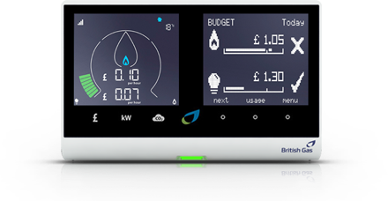
Smart Meters
The current answer to this situation is smart meters.
Smart meters are becoming more popular with companies such as British gas and EDF Energy are supplying them as standard.
Smart meters take accurate readings of your energy usage every day.
Being able to view the readings should help to save money and the environment.
Problems - they can be expensive, they often have to be installed by a professional, they usually only cover one or two resources, they can be boring to look at and rely heavily on numbers and graphs making them hard to decipher.

Slide 5
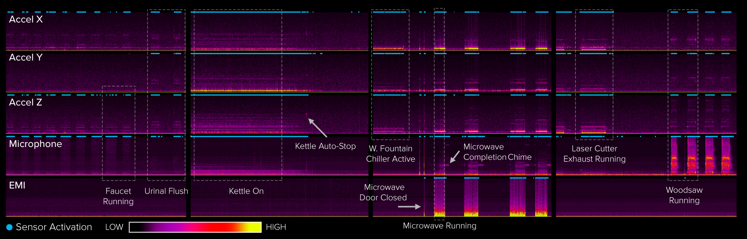
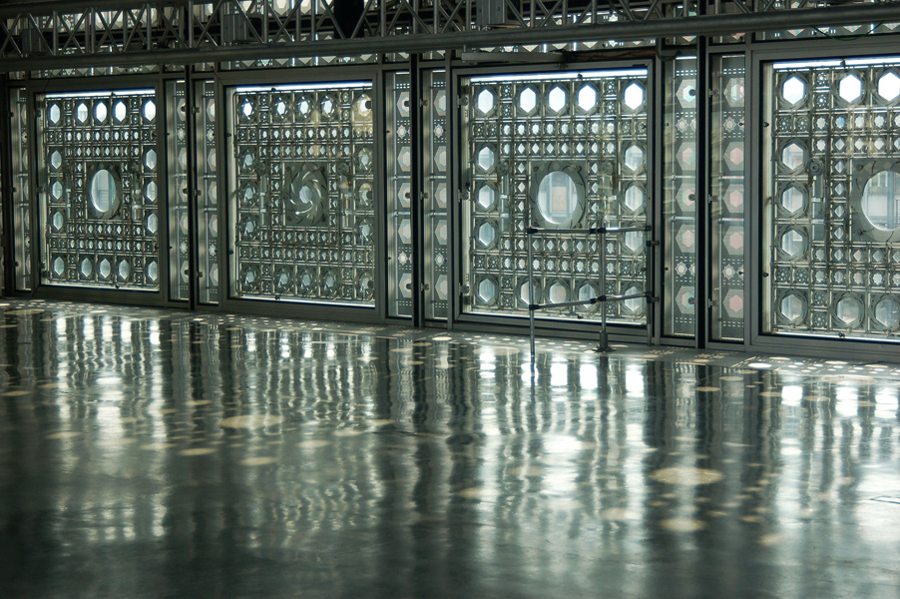
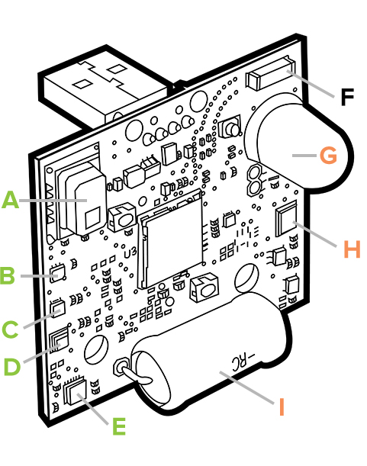
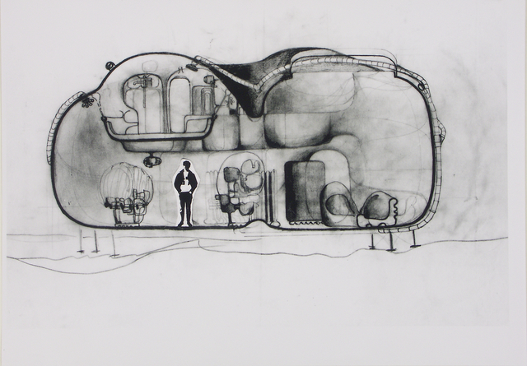
Inspirations
Arab world institute in Paris designed by Jean Nouvel.
changing metal façade that opens and closes like a cameras aperture to control interior light and temperature levels.
Synthetic sensors by Geirad Laput. A synthetic sensor is a single, highly capable sensor can indirectly monitor a large context, without direct instrumentation of objects. One sensor can detect everything in a room.
A psychotropic house is a building designed to sense and mirror the psychologic state of their occupants and change aspects such as shape and layout accordingly, some homes have complete control of all aspects.

Slide 6
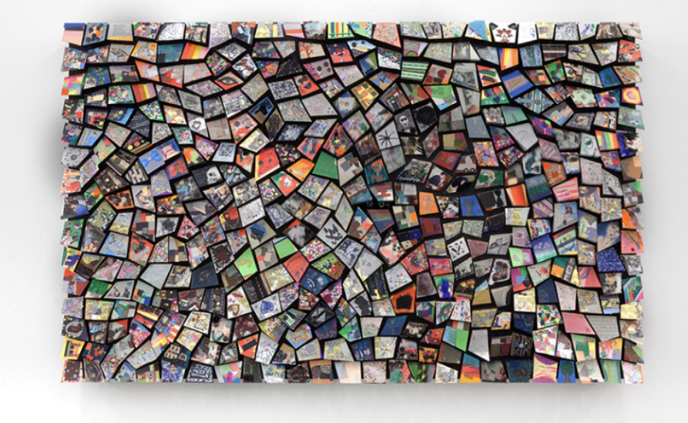
Umwelt extensions. The word umwelt in German means ‘environment’ and is used to express the fact that different environmental signals are received by different animals even within the same ecosystem and that what they can sense is the limit of their entire objective reality.
Daniel Rozin investigated the structure and materiality of images. He creates interactive installations and sculptures integrate the viewer, in real time, to create a representation of the viewer’s likeness in the object. His kinetic mirrors are often made with materials that become unexpectedly reflective.

Slide 7
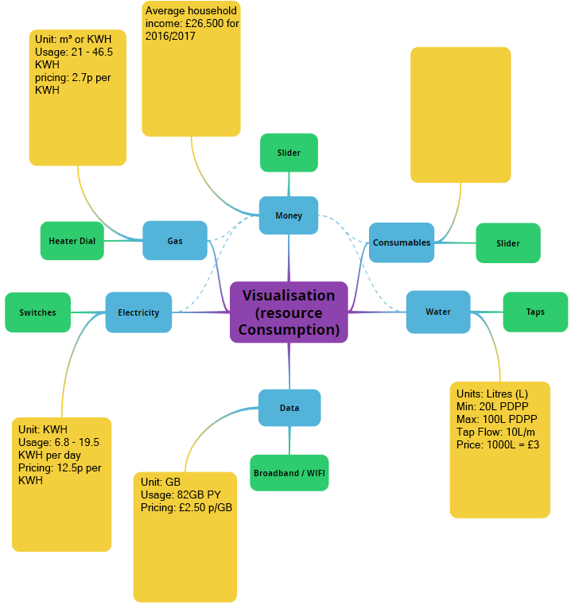
Resources Model
The model will be followed as a reference throughout the design and build of the installation.
It will include the main resources identified within the
Home, the different inputs and likely interfaces for the
Final installation, how they link together and the measurement methods and parameters.

Slide 8
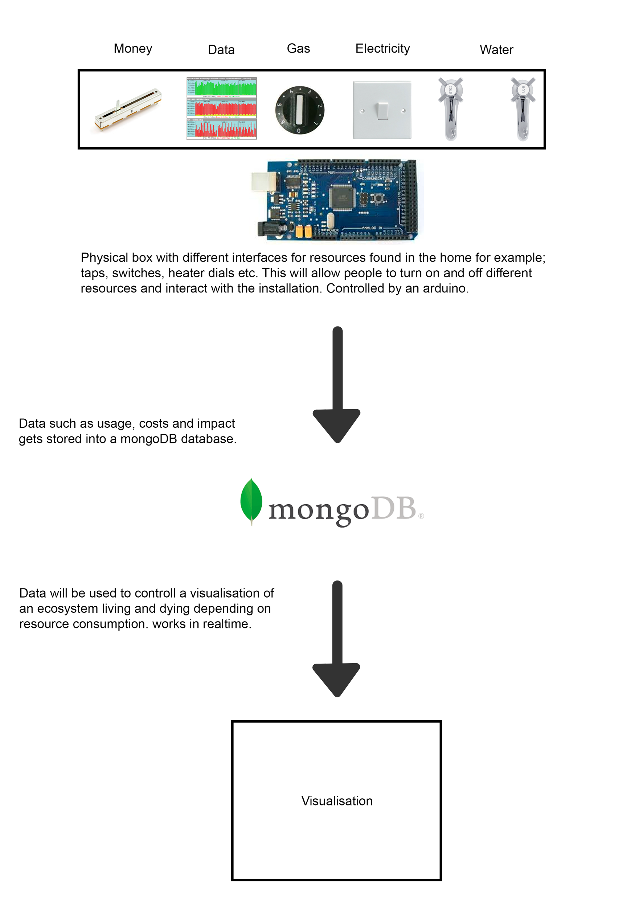
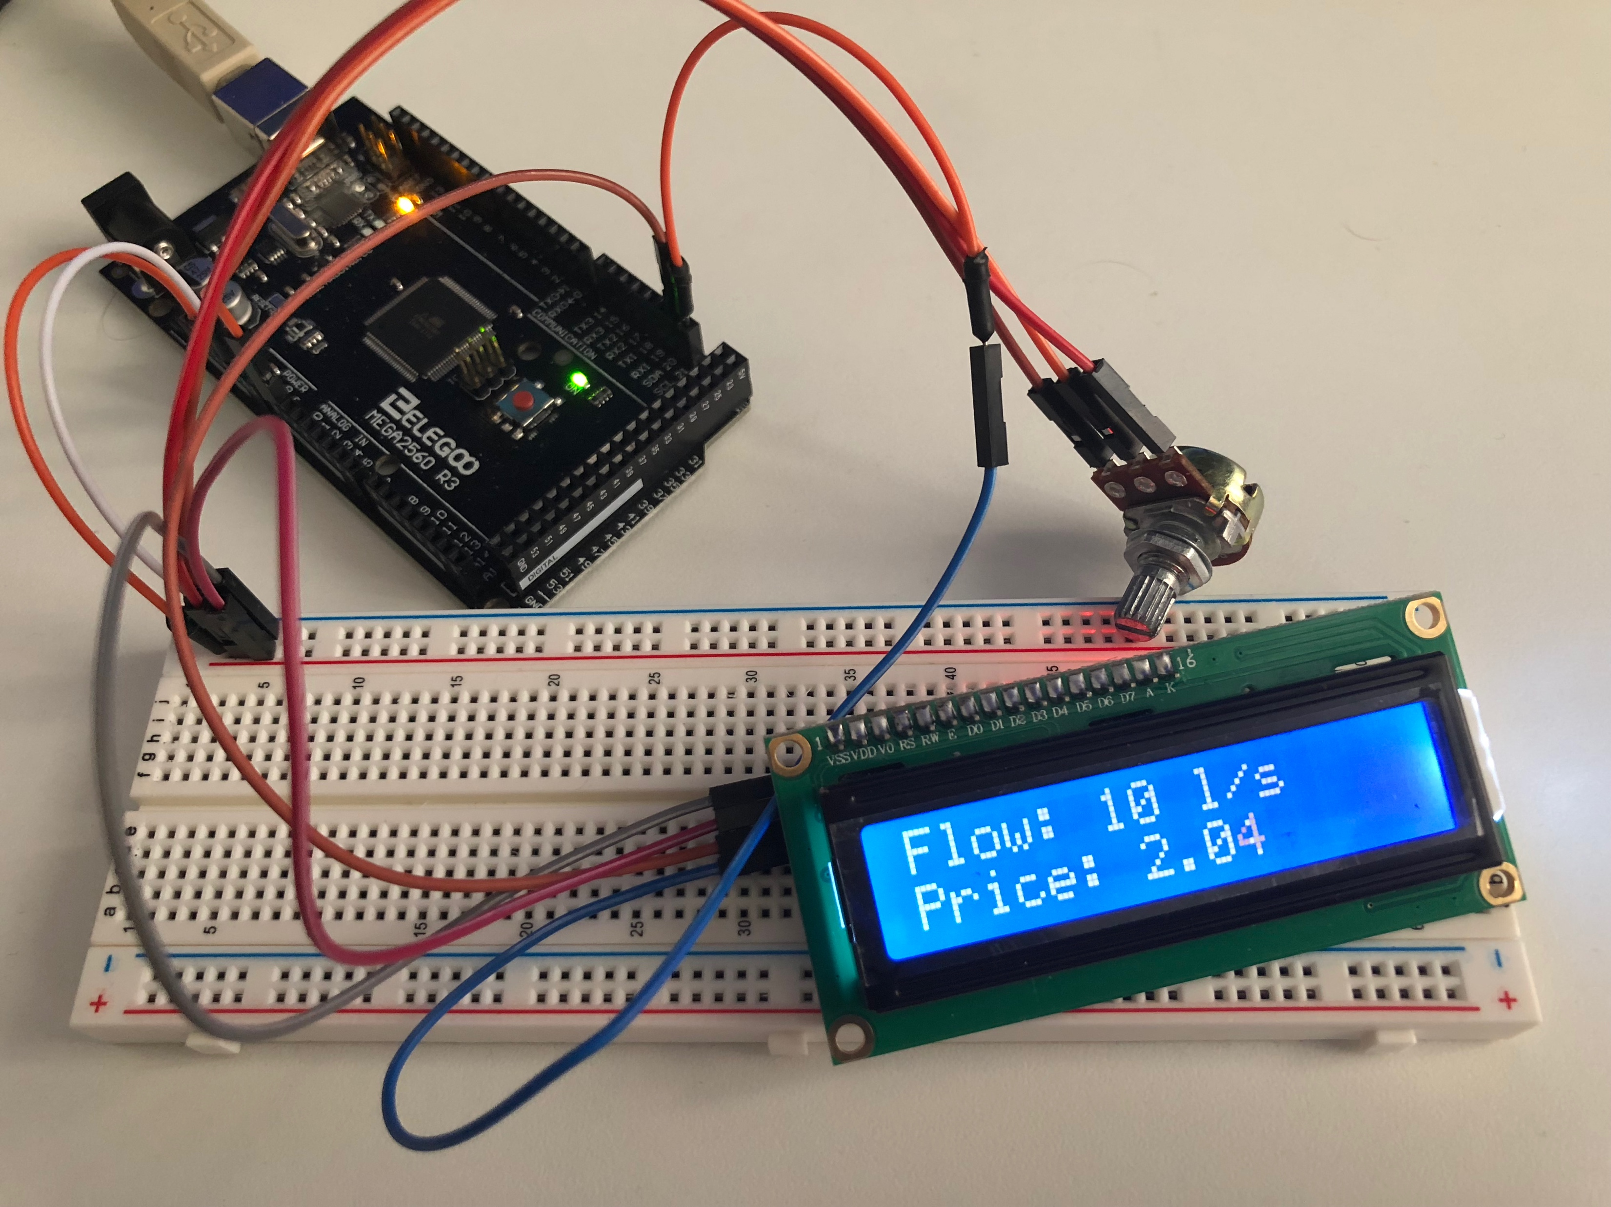
Ideas / Prototyping
Testing some ideas – below is a simulated tap, the rate of flow can be controlled with a potentiometer and you can watch the costs tick up on the lcd screen, the same has been done with 2 light switches.
Visualisation created from data as a programmed environment that can either thrive or die depending on the amount of resources currently being used. Likely using processing or p5.js.

Slide 10
Outcomes
Create an interactive art piece based on mass consumption of resources and its impact.
Introduce new ideas of what a smart meter can be and how they can be used
Raise peoples awareness of how much energy they are using.
Help lower the use of vital resources within homes and lower the impact we are having on the environment.

